Slide 1
Knowledge Sharing and Acquiring Community Application
By
G. S S S Venkat Reddy (14811A0525)
G. Lalith kumar (14811A0524)
N. Ravi Teja (14811A0547)
S. Pavan Sai (14811A0563)
Ch. Ananth Varma (14811A0513)
Under the esteemed guidance of
Mr. V. S. Ram Prasad
Assistant Professor
Department of Computer Science and Engineering

Slide 2
ABSTRACT
The knowledge sharing and acquiring community application provides great opportunity for students and experts (students / teachers / professionals) to share their expertise and for acquiring knowledge in the single platform by using android application with network (by using internet). Here the community can be described as group of people such as students, teachers, professors, experts, professionals, etc,. There are many Question and Answer community platforms for sharing and acquiring knowledge, but the main purpose developing this project is to provide expert role for a student for answering the questions posted by other users (mainly students). By this, the knowledge which has gained by the student is going to be useful for others, by this he / she can gain several factors like confidence, stability, performance, etc. over the subject will be enhanced.

Slide 3
EXISTING SYSTEM
There are many online forums, question and answer communities where students can share and acquire knowledge regarding to education, politics, emerging technologies, ..etc. But coming to education point of view, these forums and Q & A communities are not providing efficient service to under-graduate level students. Most of these platforms are providing their services through websites. Coming to understanding capability of students the answers which were provided by experts are not easy to understand and some of the subjects are not present in the Q & A platforms, so he / she not able to ask the question. There is no chance to students who got better knowledge on the subject for sharing.

Slide 4
PROPOSED SYSTEM
We are developing a knowledge driven community application for this online platform which facilitates collaboration among people. We have chosen Android Platform for the development of this application. We are designing the application in such a way that every individual can share and acquire knowledge (in terms of education) effectively. Here new users can play, which means probability of getting response to the users is more because we are providing In-app notifications. Here any individual can engage the role of student and subject matter expert (SME/teacher) simultaneously based on the circumstances.

Slide 5
LITERATURE SURVEY
Community based question and answering (CQA) sites and applications achieve knowledge sharing among community users through a participatory platform where users can ask and answer questions for each other. Since the first CQA site appeared in Korea in 2002, these services have been developing at a very fast pace in many parts of the world.
Community driven Question Answering (CQA) websites like Stack Overflow, Quora and Yahoo! Answers are popular contemporary genre of websites on the Internet. CQA websites follow a standard Q&A format where a user asks a question on a problem she faces; while other users (who may have some prior expertise) respond with their answers on the question. Effectively, CQA websites follow a crowd sourced model in which the knowledge of experts is exploited to form a large scale knowledge base on variety of topics. Stack Exchange is a platform which provides libraries to deploy topic-based community powered Q&A websites.

Slide 6
TECHNOLOGIES USED
Android
JAVA
PHP
MySQL
Firebase

Slide 7
ANDROID
Android is a mobile operating system developed by open handset alliance led by Google. Android is based on modified version of the Linux-kernel and primarily for touch screen mobile devices such as smart phones and tablets. It is completely open-source operating system. The code is freely available and can be modified by several developers as needed to create custom mobile solutions.
Some of the important features of Android Studio are Gradle-based build support, Android-specific refactoring and quick fixes, Lint tools to catch performance, usability, version compatibility and other problems, Support for building Android Wear Apps and Android Virtual Device (Emulator) to run and debug Apps in Android Studio.

Slide 8
JAVA
Java technology is both a programming language and an application software development platform.
Java as programming language
Java is a general-purpose computer programming language that is concurrent, class-based and object-oriented. It is intended to let application developers “Write Once Run Anywhere” (WORA), i.e, the compiled Java code can run on all platforms that support java without need for recompilation. Hence, Java is Platform Independent language. Java applications are typically compiled to bytecode that can run on any JVM (Java Virtual Machine) regardless of computer architecture.

Slide 9
PHP
PHP- Hypertext preprocessor, formerly known as personal homepage. It is a server-side scripting language and a powerful tool for making dynamic and interactive web-pages. It is used as gateway between application and the database of the server. It is a widely used, open source scripting language. PHP scripts are executed on the server. PHP can generate dynamic page content. PHP can perform CRUD operations on the server. PHP can collect form data. It can send and receive cookies. It can add, delete, modify data in your database. It can be used to control user-access. It can encrypt data.

Slide 10
MYSQL
MySQL is an open-source relational database management system. Many applications are using MySQL database. MySQL is one of the best RDBMS being used for developing web-based software applications. MySQL is a database system that runs on a server. MySQL uses standard SQL. The data in a MySQL database is stored in table format. A table is a collection of columns and rows.
MySQL Database
MySQL is released under an open-source license. So you have nothing to pay to use it.
It is a very powerful program in its own right. It handles a large subset of the functionality of the most expensive and powerful database packages. It uses a standard form of the well-known SQL data language. It works on many operating systems and with many languages including PHP, PERL, C, C++, JAVA, etc.

Slide 11
FIREBASE
Firebase is a mobile and web application development platform developed by Firebase, Inc. in 2011, then acquired by Google in 2014.
Services provided:
Firebase Cloud Messaging
Formerly known as Google Cloud Messaging (GCM), Firebase Cloud Messaging (FCM) is a cross-platform solution for messages and notifications for Android, iOS, and web applications, which currently can be used at no cost.
Firebase Authentication
Firebase Authentication is a service that can authenticate users using only client-side code. It supports social login providers Facebook, GitHub, Twitter and Google (and Google Play Games). Additionally, it includes a user management system whereby developers can enable user authentication with email and password login stored with Firebase.

Slide 12
Real-time Database
Firebase provides a real-time database and backend as a service. The service provides application developers an API that allows application data to be synchronized across clients and stored on Firebase's cloud.
Firebase Storage
Firebase Storage provides secure file uploads and downloads for Firebase apps, regardless of network quality. The developer can use it to store images, audio, video, or other user-generated content. Firebase Storage is backed by Google Cloud Storage.
Firebase Hosting , ..etc,.
Coming to our project development, we are using Firebase Cloud Messaging (FCM) service for getting notifications in the Android mobile phones. The messaging service is free of cost for that we have get token Id from firebase.

Slide 13
SYSTEM ANALYSIS

Slide 14
FEASIBILITY STUDY
Technical Feasibility
This assessment is based on an outline design of system requirements to determine whether the company has the technical expertise to handle completion of the project. Our team has the technical expertise in JAVA, PHP, MySQL..etc., for the development of this project.
Legal Feasibility
Legal feasibility determines whether the proposed system conflicts with legal requirements, in terms of providing security. In this project we are providing login id and password for the users for secure login. We are using active and automatic moderators for controlling wrongly misplaced words / statements.

Slide 15
Operational Feasibility
Operational feasibility is the measure of how well a proposed system solves the problem and how it satisfies the requirements identified in the requirement analysis phase of system development. We are providing subjective-tags, real-time notifications in application, etc., for solving the problems in existed system.
Schedule Feasibility
A project will fail if it takes too long to be completed before it is useful. Typically this means estimating how long the system will take to develop, and if it can be completed in a given time period using some methods like payback period. Our project will take 3 months approximately for development.

Slide 16
SYSTEM REQUIREMENTS SPECIFICATIONS
Software Requirements (Minimal)
Operating System: Windows XP
Technologies: JAVA, PHP, Android
IDE: Android Studio
Database: MySQL
Toolkit: Android mobile phone
Front-end: XML (for setting layout of the app)
Back-end: JAVA, PHP, MySQL

Slide 17
Hardware Requirements (Minimal)
Processor: Pentium
Speed: 1.8GHz
RAM: 4GB
Hard Disk: 40GB for Android studio tools (SDK’s, API’s….)

Slide 18
SYSTEM DESIGN

Slide 19
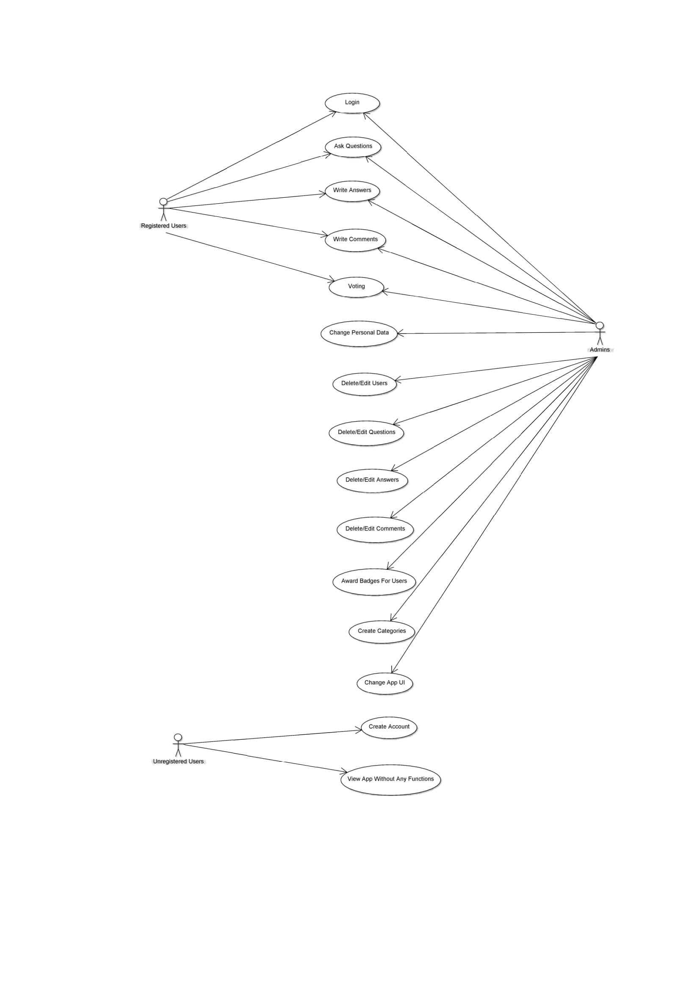
USE CASE DIAGRAM

Slide 20
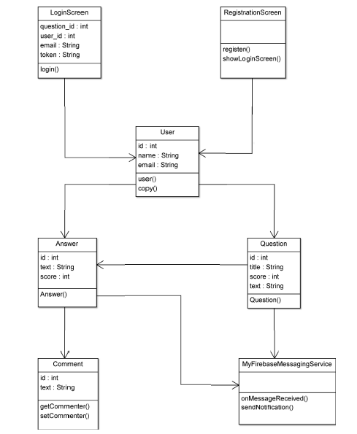
CLASS DIAGRAM

Slide 21
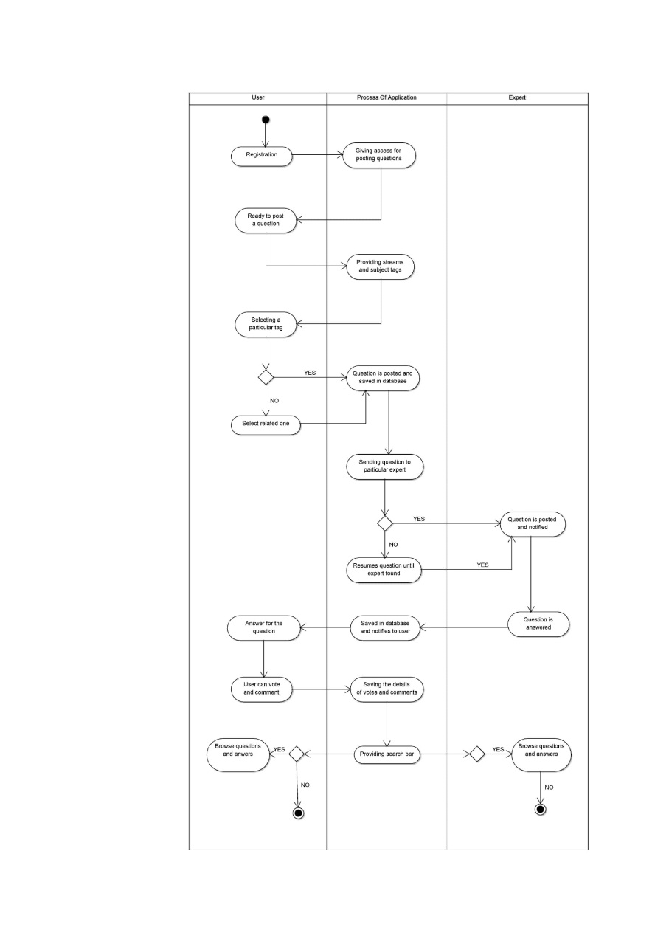
ACTIVITY DIAGRAM

Slide 22
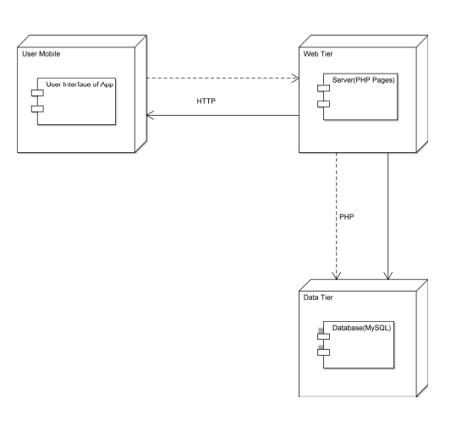
DEPLOYMENT DIAGRAM

Slide 23
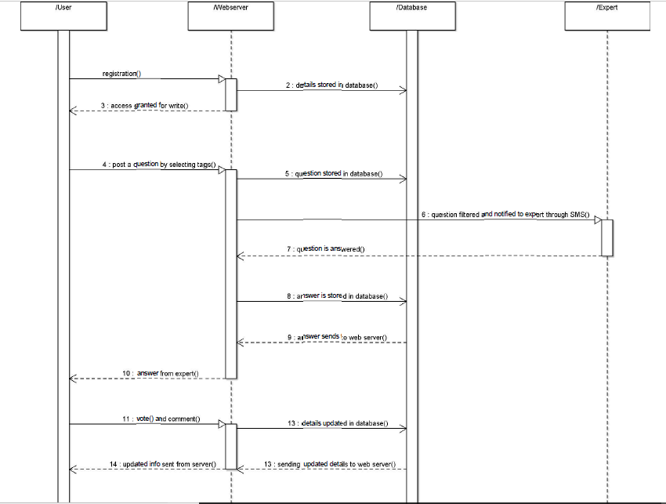
SEQUENCE DIAGRAM

Slide 24
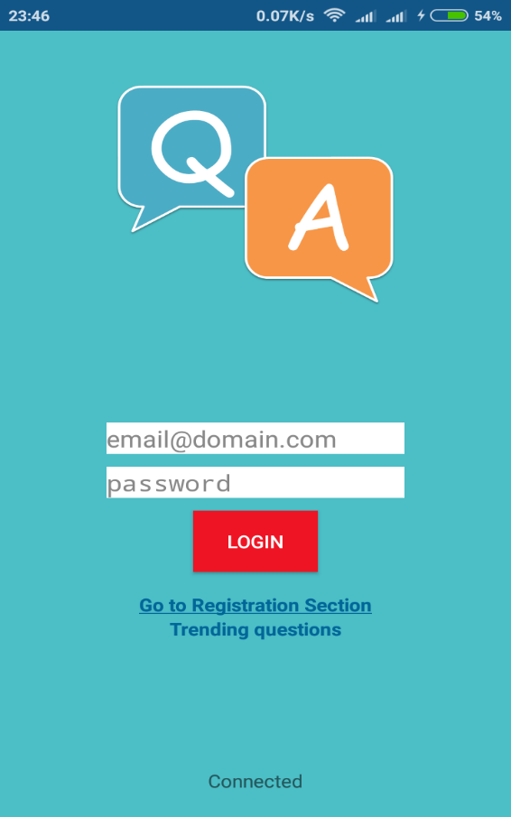
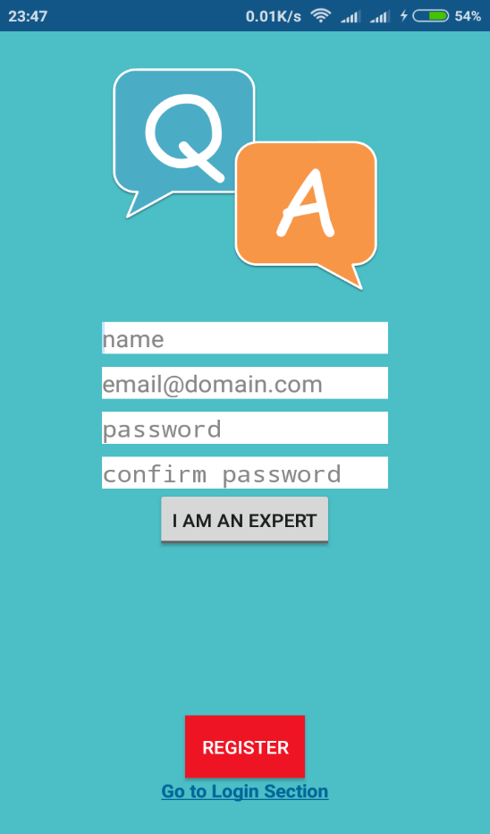
SAMPLE OUTPUTS

Slide 25
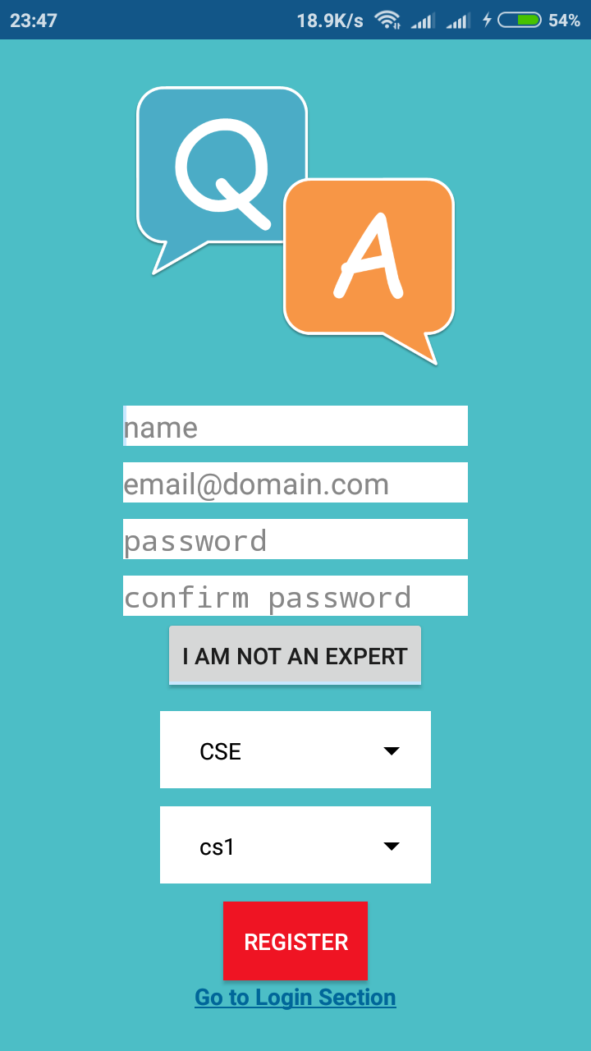
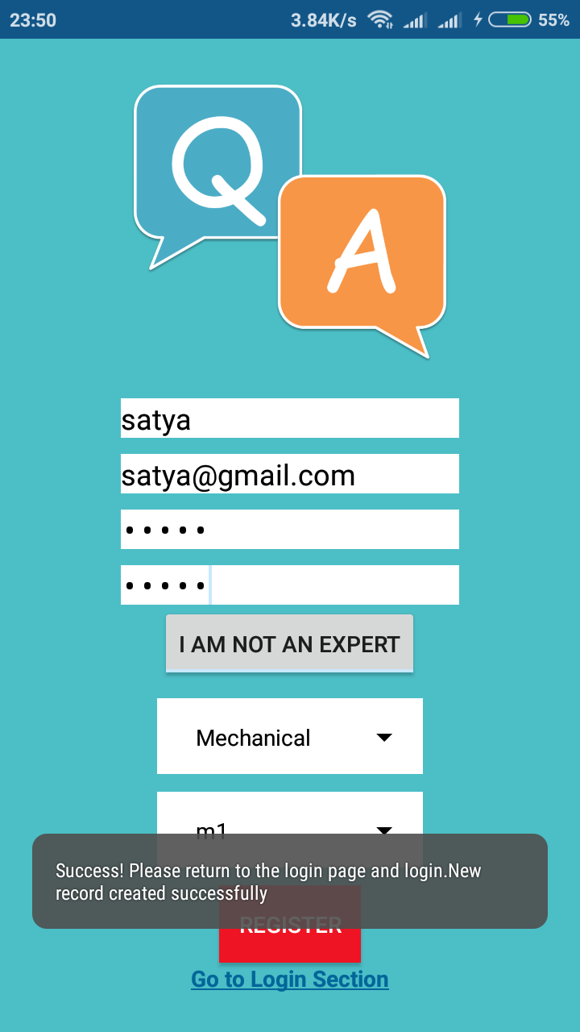

Slide 26
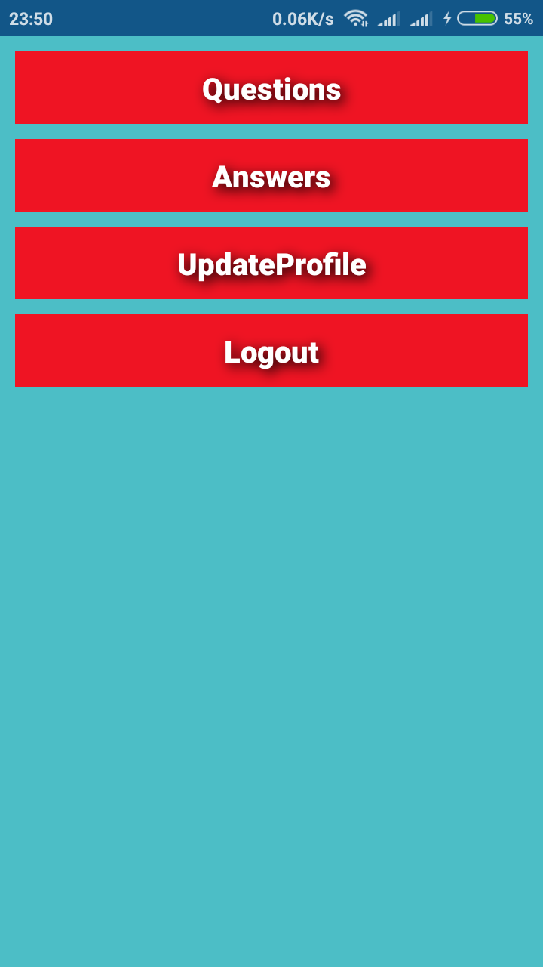
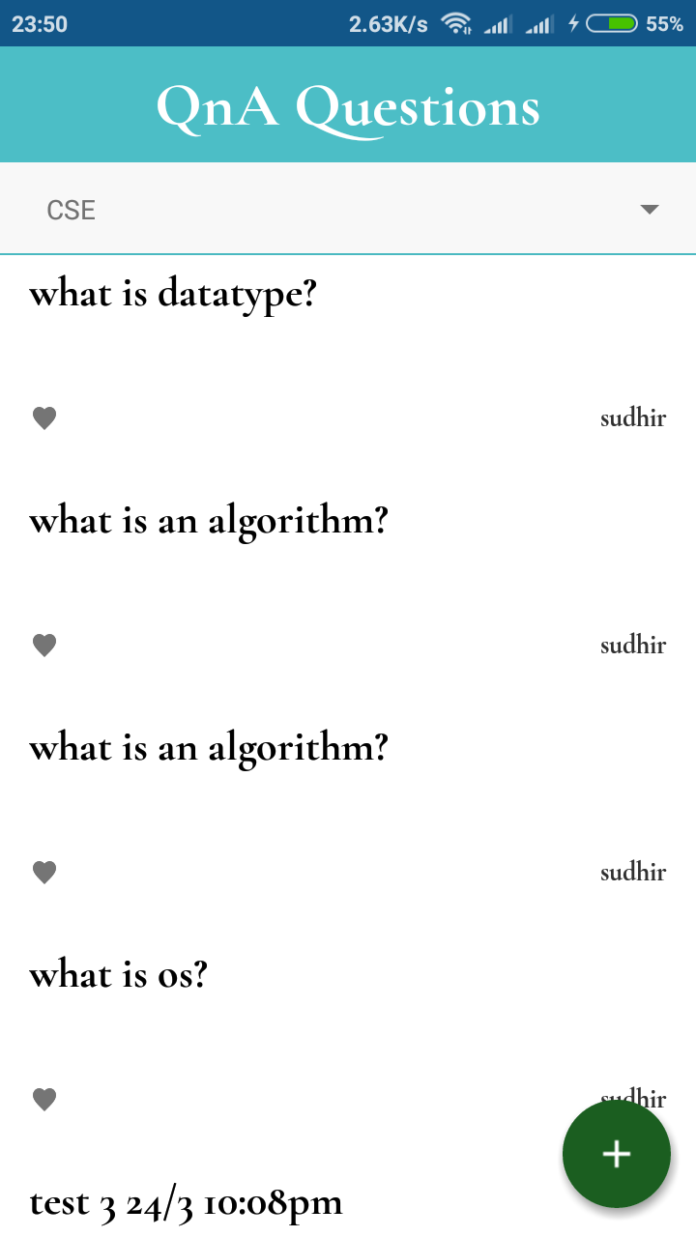

Slide 27
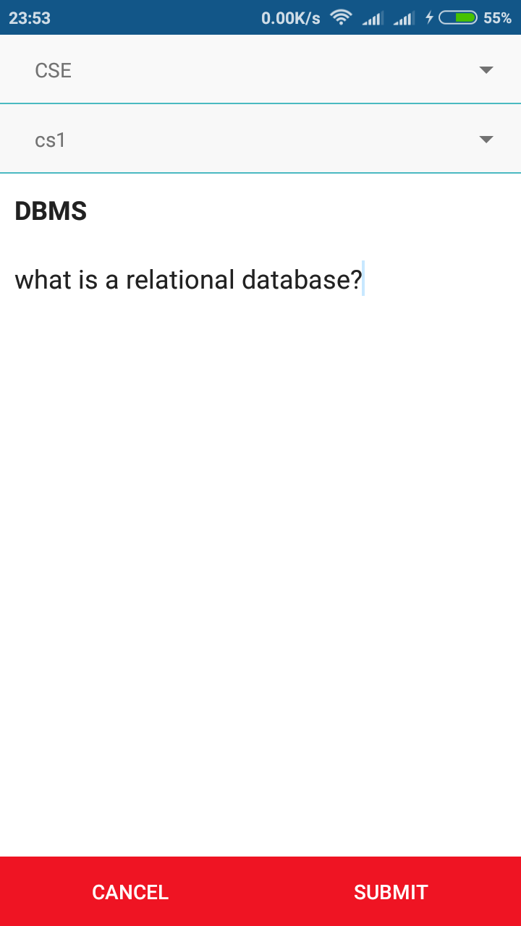
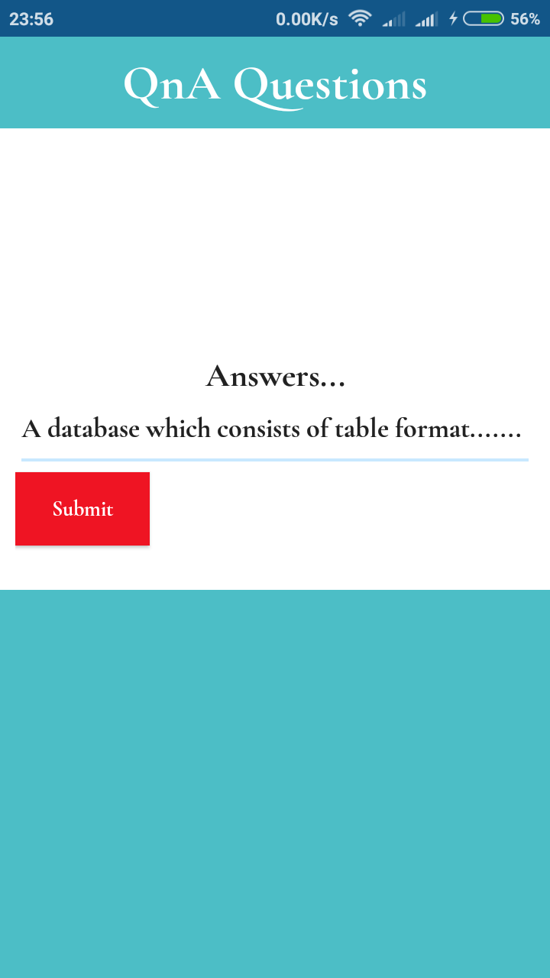

Slide 28
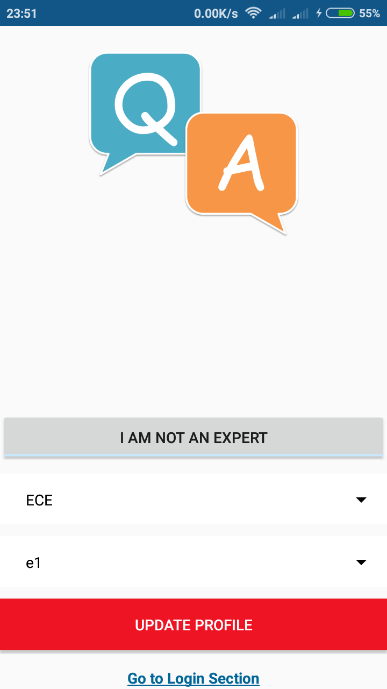
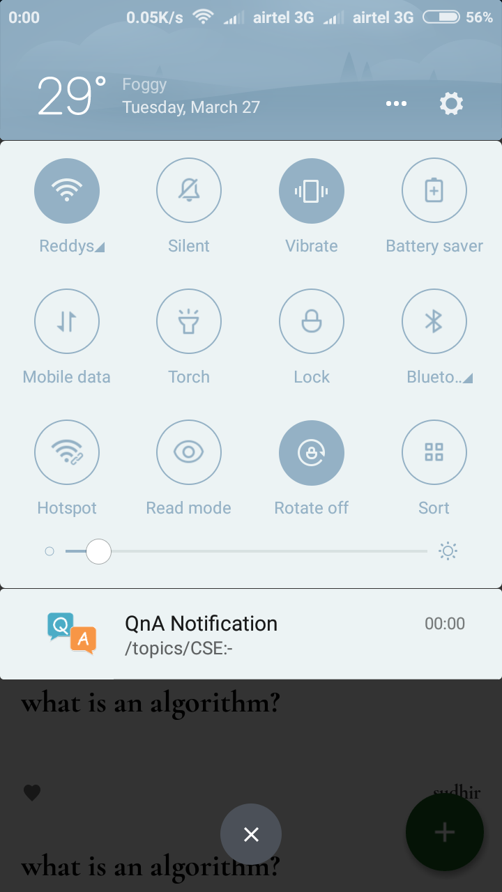

Slide 29
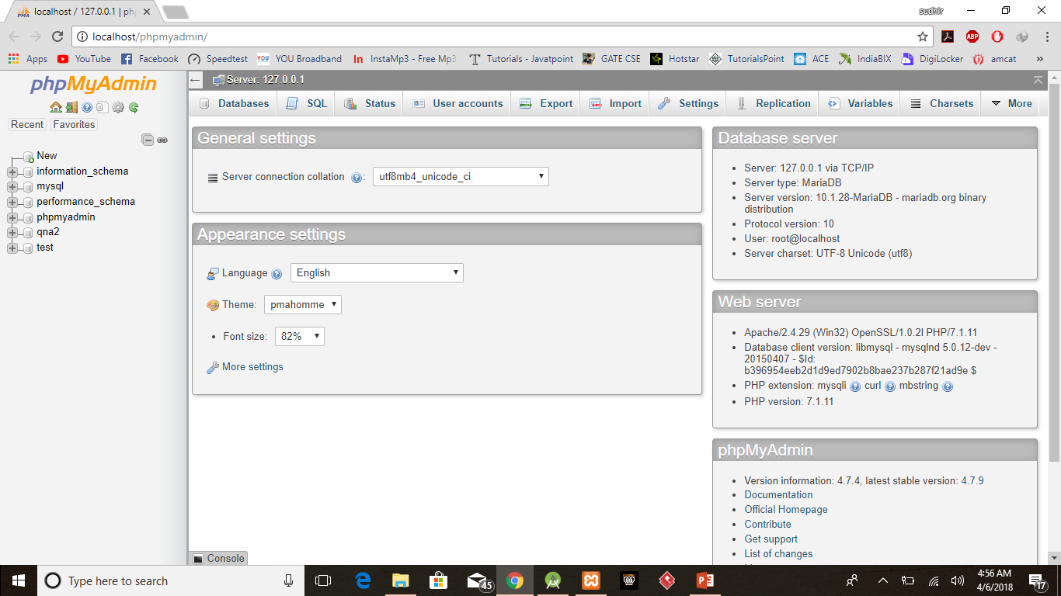
MySQL DATABASE

Slide 30
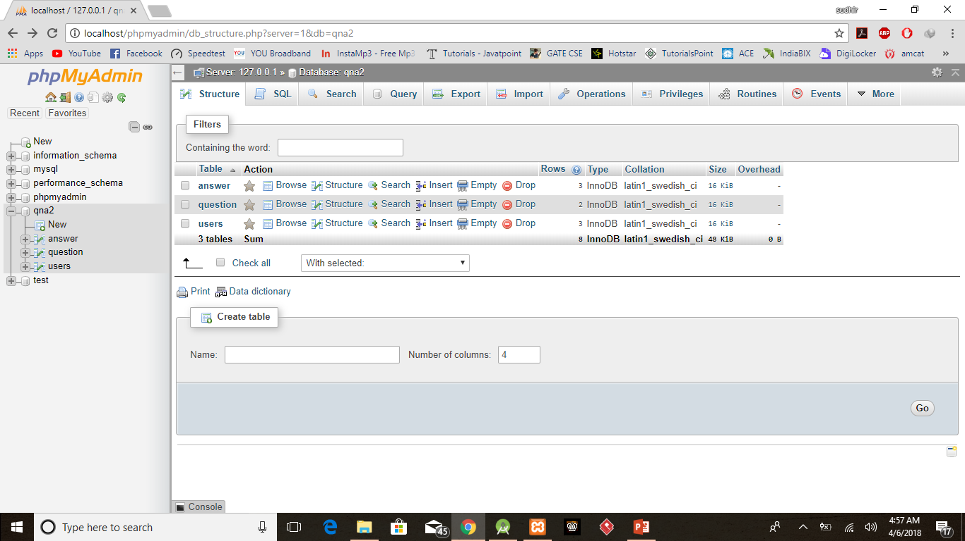

Slide 31
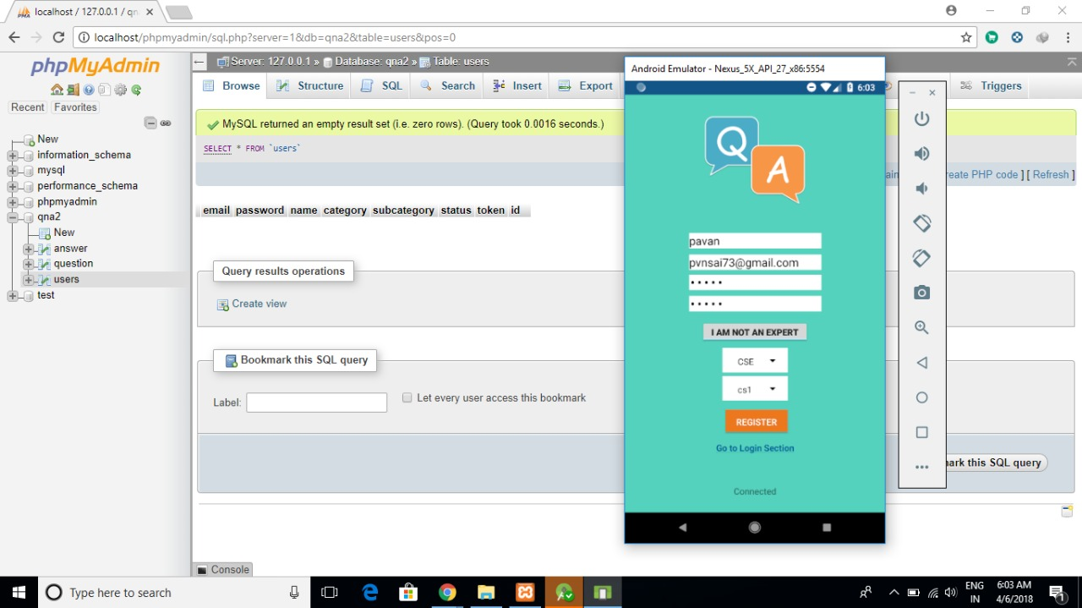

Slide 32
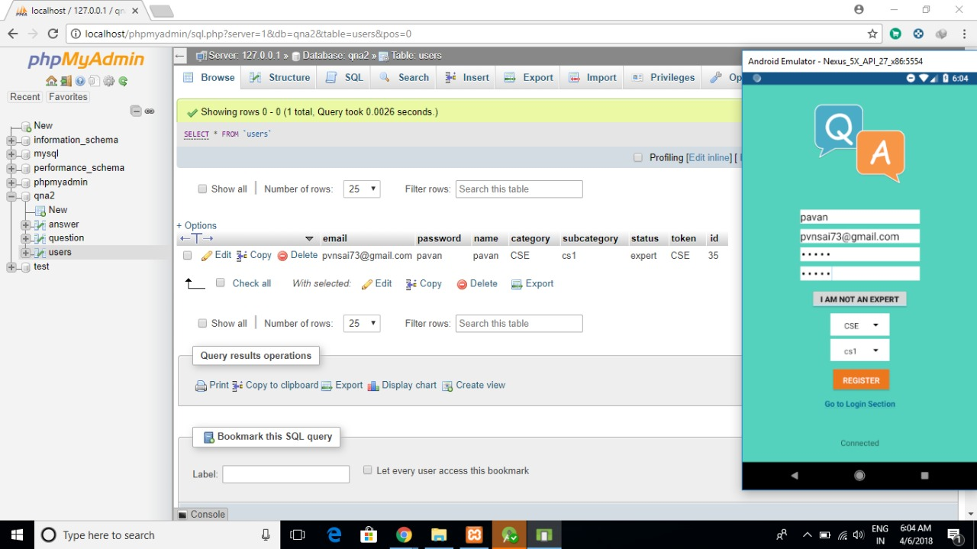

Slide 33
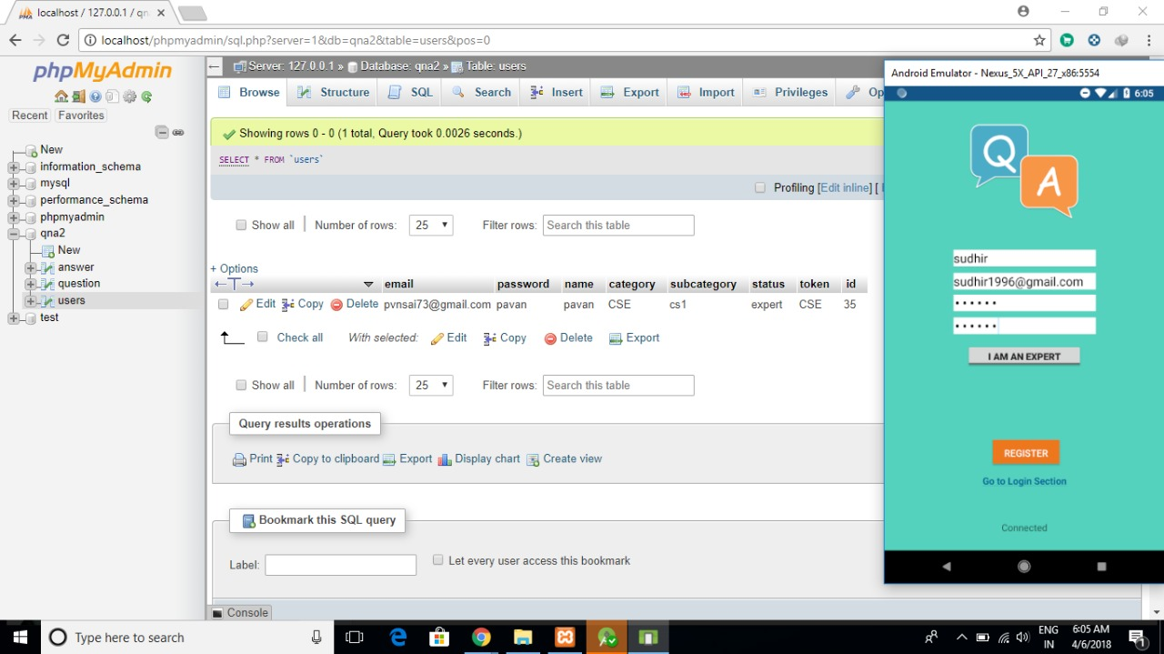

Slide 34
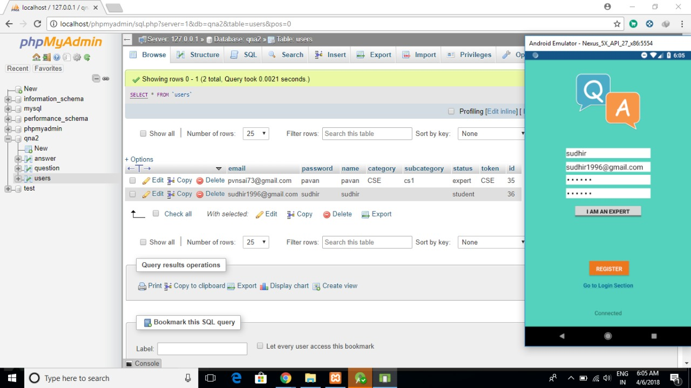

Slide 35
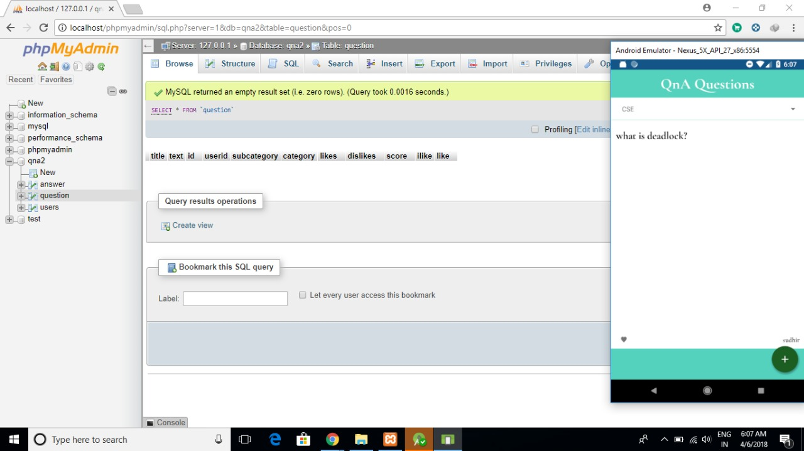

Slide 36
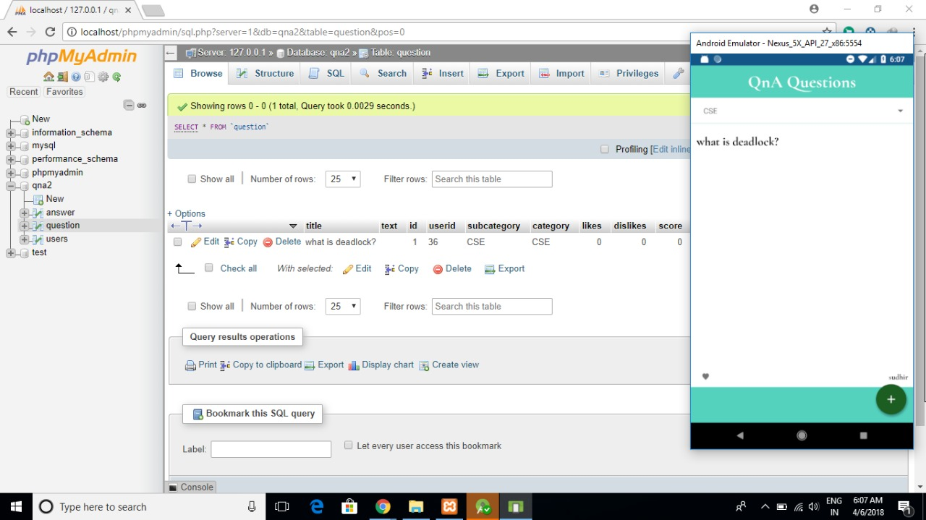

Slide 37
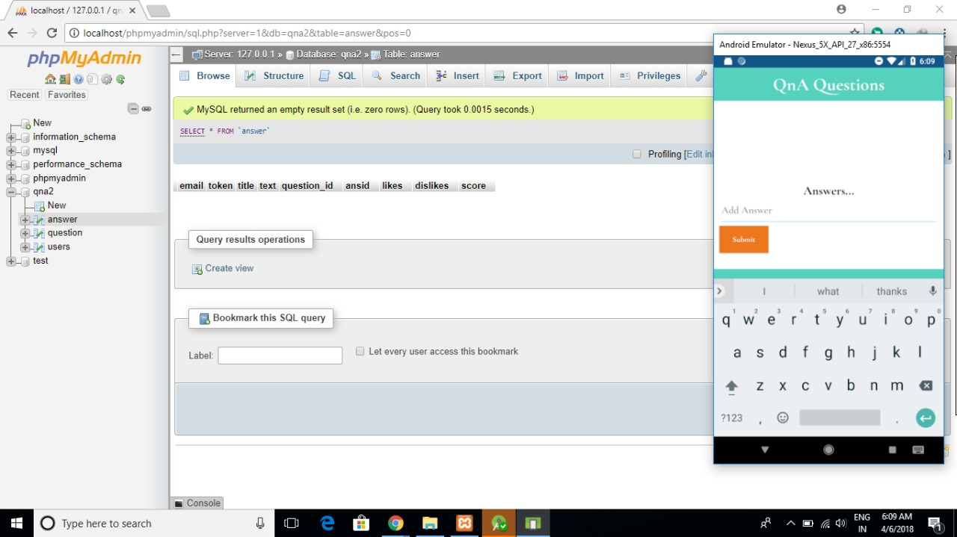

Slide 38
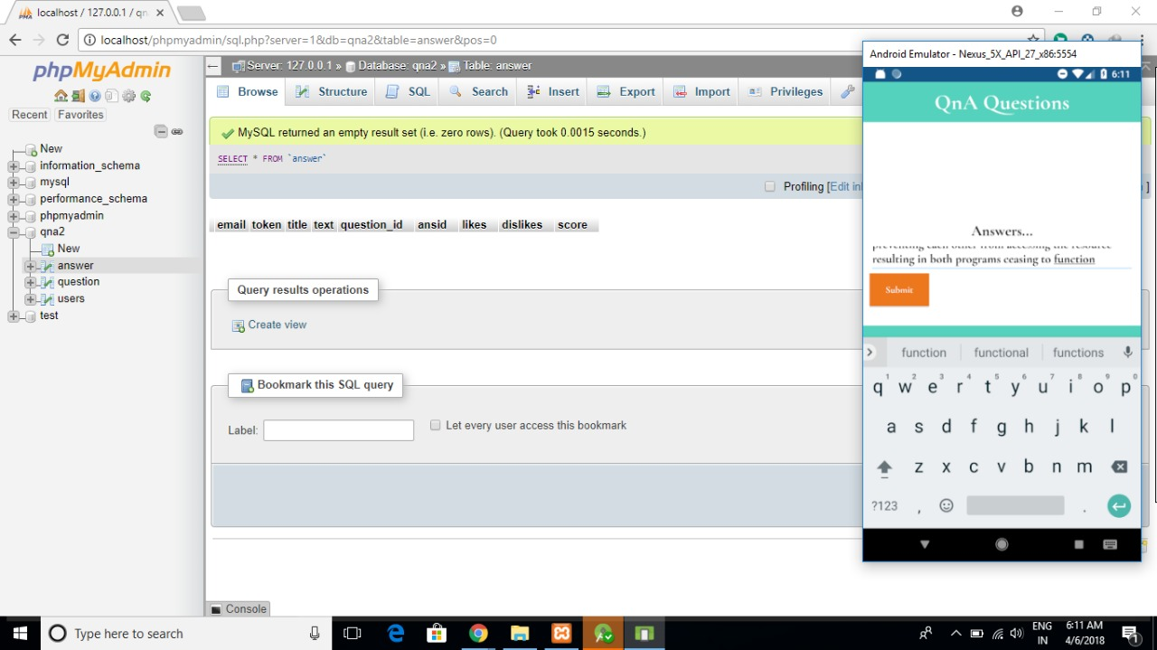

Slide 39
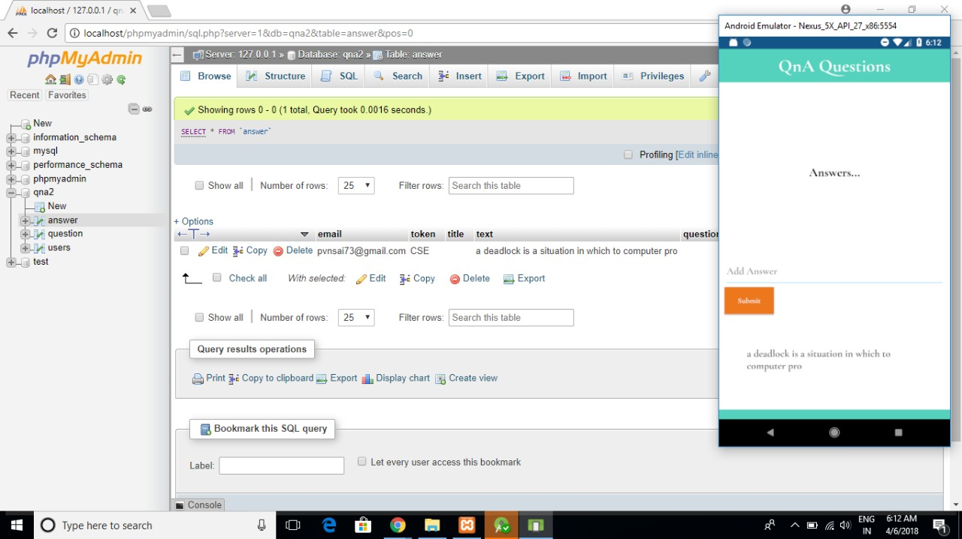

Slide 40
SYSTEM TESTING Test Cases
Step No. | Step Description | Test Data | Expected Result | Overall Result
1 | User launches the application by pressing app icon |  | Main activity window must be displayed | success

Slide 41
Step No. | Step Description | Test Data | Expected Result | Overall Result
1 | User can register as student and expert by filling the details | Details are stored in the database | Toast message must be shown as registration success | success

Slide 42
Step No. | Step Description | Test Data | Expected Result | Overall Result
1 | User can login into the application by using login credentials | Details are verified and validated from database | Toast message must be shown as login success | success
2 | After successful login |  | Menu activity must be displayed with some Buttons having functionalities
3 | Buttons |  | i.Questions ii.Answers iii.Update profile iv.Logout

Slide 43
CONCLUSION
Our hypothesis was that knowledge sharing through community platforms based on Android applications, websites, etc,.are the best ways to share and acquire knowledge throughout the world. By this multiple number of users (students and experts) from different places can be present in single platform in our project. So, that the queries of students can be easily solved by experts. For increasing response time we are providing In-app notifications, by this students can get a immediate response from the experts. Mainly this application is useful for under-graduate level students of all categories.

Slide 44
FUTURE ENHANCEMENTS
We will categorize experts based on sub-streams also.
We are going to add experts of different streams from different universities and organizations for increasing reliability and quality of answers.
We will provide various category of materials of different streams in the form of PDF’s, DOC’s, etc., which are useful for the users as reference.
We will provide best search engine for searching questions and answers.
We will provide adding picture functionality while posting and answering the question.

Slide 45
THANK YOU

